Slide 1
CS162 Operating Systems and Systems Programming Lecture 5 Introduction to Networking, Concurrency (Processes and Threads)
September 10th, 2018
Prof. Ion Stoica
http://cs162.eecs.Berkeley.edu

Slide 2
Communication between processes
Can we view files as communication channels?
Producer and Consumer of a file may be distinct processes
May be separated in time (or not)
However, what if data written once and consumed once?
Don’t we want something more like a queue?
Can still look like File I/O!
write(wfd, wbuf, wlen);
n = read(rfd,rbuf,rmax);

Slide 3
Communication Across the world looks like file IO
write(wfd, wbuf, wlen);
n = read(rfd,rbuf,rmax);
Connected queues over the Internet
But what’s the analog of open?
What is the namespace?
How are they connected in time?

Slide 4
Request Response Protocol
Client (issues requests)
Server (performs operations)
write(rqfd, rqbuf, buflen);
requests
n = read(rfd,rbuf,rmax);
wait
service request
write(wfd, respbuf, len);
responses
n = read(resfd,resbuf,resmax);

Slide 5
Request Response Protocol
Client (issues requests)
Server (performs operations)
write(rqfd, rqbuf, buflen);
requests
n = read(rfd,rbuf,rmax);
wait
service request
write(wfd, respbuf, len);
responses
n = read(resfd,resbuf,resmax);

Slide 6
Client-Server Models
Client 1
Client 2
Server
***
Client n
File servers, web, FTP, Databases, …
Many clients accessing a common server

Slide 7
Sockets
Socket: an abstraction of a network I/O queue
Mechanism for inter-process communication
Embodies one side of a communication channel
Same interface regardless of location of other end
Local machine (“UNIX socket”) or remote machine (“network socket”)
First introduced in 4.2 BSD UNIX: big innovation at time
Now most operating systems provide some notion of socket
Data transfer like files
Read / Write against a descriptor
Over ANY kind of network
Local to a machine
Over the internet (TCP/IP, UDP/IP)
OSI, Appletalk, SNA, IPX, SIP, NS, …

Slide 8


Silly Echo Server – running example
Client (issues requests)
Server (performs operations)
gets(fd,sndbuf, …);
requests
write(fd, buf,len);
n = read(fd,buf,);
wait
print
write(fd, buf,);
responses
n = read(fd,rcvbuf, );
print

Slide 9
Echo client-server example
void client(int sockfd) {
int n;
char sndbuf[MAXIN]; char rcvbuf[MAXOUT];
getreq(sndbuf, MAXIN); /* prompt */
while (strlen(sndbuf) > 0) {
write(sockfd, sndbuf, strlen(sndbuf)); /* send */
memset(rcvbuf,0,MAXOUT); /* clear */
n=read(sockfd, rcvbuf, MAXOUT-1); /* receive */
write(STDOUT_FILENO, rcvbuf, n); /* echo */
getreq(sndbuf, MAXIN); /* prompt */
}
}
void server(int consockfd) {
char reqbuf[MAXREQ];
int n;
while (1) {
memset(reqbuf,0, MAXREQ);
n = read(consockfd,reqbuf,MAXREQ-1); /* Recv */
if (n <= 0) return;
n = write(STDOUT_FILENO, reqbuf, strlen(reqbuf));
n = write(consockfd, reqbuf, strlen(reqbuf)); /* echo*/
}
}

Slide 10
Prompt for input
char *getreq(char *inbuf, int len) {
/* Get request char stream */
printf("REQ: "); /* prompt */
memset(inbuf,0,len); /* clear for good measure */
return fgets(inbuf,len,stdin); /* read up to a EOL */
}

Slide 11
Socket creation and connection
File systems provide a collection of permanent objects in structured name space
Processes open, read/write/close them
Files exist independent of the processes
Sockets provide a means for processes to communicate (transfer data) to other processes.
Creation and connection is more complex
Form 2-way pipes between processes
Possibly worlds away

Slide 12
Namespaces for communication over IP
Hostname
www.eecs.berkeley.edu
IP address
128.32.244.172 (IPv4 32-bit)
fe80::4ad7:5ff:fecf:2607 (IPv6 128-bit)
Port Number
0-1023 are “well known” or “system” ports
Superuser privileges to bind to one
1024 – 49151 are “registered” ports (registry)
Assigned by IANA for specific services
49152–65535 (2¹⁵+2¹⁴ to 2¹⁶−1) are “dynamic” or “private”
Automatically allocated as “ephemeral Ports”

Slide 13
Using Sockets for Client-Server (C/C++)
On server: set up “server-socket”
Create socket; bind to protocol (TCP), local address, port
Call listen(): tells server socket to accept incoming requests
Perform multiple accept() calls on socket to accept incoming connection request
Each successful accept() returns a new socket for a new connection; can pass this off to handler thread
On client:
Create socket; bind to protocol (TCP), remote address, port
Perform connect() on socket to make connection
If connect() successful, have socket connected to server

Slide 14
Socket Setup over TCP/IP
Server
Socket
Request Connection
new
socket
socket
socket
connection
Client
Server
Server Socket: Listens for new connections
Produces new sockets for each unique connection
Things to remember:
Connection involves 5 values: [ Client Addr, Client Port, Server Addr, Server Port, Protocol ]
Often, Client Port “randomly” assigned by OS during client socket setup
Server Port often “well known” (0-1023)
80 (web), 443 (secure web), 25 (sendmail), etc

Slide 15
Example: Server Protection and Parallelism
Client
Server
Create Server Socket
Create Client Socket
Bind it to an Address
(host:port)
Connect it to server (host:port)
Listen for Connection
Accept connection
child
Connection
Socket
Parent
Close Listen Socket
Close Connection
Socket
write request
read request
read response
write response
Close Server Socket
Close Client Socket
Close Connection Socket

Slide 16
Server Protocol (v3)
listen(lstnsockfd, MAXQUEUE);
while (1) {
consockfd = accept(lstnsockfd, (struct sockaddr *) &cli_addr,
&clilen);
cpid = fork(); /* new process for connection */
if (cpid > 0) { /* parent process */
close(consockfd);
//tcpid = wait(&cstatus);
} else if (cpid == 0) { /* child process */
close(lstnsockfd); /* let go of listen socket */
server(consockfd);
close(consockfd);
exit(EXIT_SUCCESS); /* exit child normally */
}
}
close(lstnsockfd);

Slide 17
Server Protocol (v3)
listen(lstnsockfd, MAXQUEUE);
while (1) {
consockfd = accept(lstnsockfd, (struct sockaddr *) &cli_addr,
&clilen);
cpid = fork(); /* new process for connection */
if (cpid > 0) { /* parent process */
close(consockfd);
//tcpid = wait(&cstatus);
} else if (cpid == 0) { /* child process */
close(lstnsockfd); /* let go of listen socket */
server(consockfd);
close(consockfd);
exit(EXIT_SUCCESS); /* exit child normally */
}
}
close(lstnsockfd);

Slide 18
Server Protocol (v3)
listen(lstnsockfd, MAXQUEUE);
while (1) {
consockfd = accept(lstnsockfd, (struct sockaddr *) &cli_addr,
&clilen);
cpid = fork(); /* new process for connection */
if (cpid > 0) { /* parent process */
close(consockfd);
//tcpid = wait(&cstatus);
} else if (cpid == 0) { /* child process */
close(lstnsockfd); /* let go of listen socket */
server(consockfd);
close(consockfd);
exit(EXIT_SUCCESS); /* exit child normally */
}
}
close(lstnsockfd);

Slide 19
Server Protocol (v3)
listen(lstnsockfd, MAXQUEUE);
while (1) {
consockfd = accept(lstnsockfd, (struct sockaddr *) &cli_addr,
&clilen);
cpid = fork(); /* new process for connection */
if (cpid > 0) { /* parent process */
close(consockfd);
//tcpid = wait(&cstatus);
} else if (cpid == 0) { /* child process */
close(lstnsockfd); /* let go of listen socket */
server(consockfd);
close(consockfd);
exit(EXIT_SUCCESS); /* exit child normally */
}
}
close(lstnsockfd);

Slide 20
Server Protocol (v3)
listen(lstnsockfd, MAXQUEUE);
while (1) {
consockfd = accept(lstnsockfd, (struct sockaddr *) &cli_addr,
&clilen);
cpid = fork(); /* new process for connection */
if (cpid > 0) { /* parent process */
close(consockfd);
//tcpid = wait(&cstatus);
} else if (cpid == 0) { /* child process */
close(lstnsockfd); /* let go of listen socket */
server(consockfd);
close(consockfd);
exit(EXIT_SUCCESS); /* exit child normally */
}
}
close(lstnsockfd);

Slide 21
Server Protocol (v3)
listen(lstnsockfd, MAXQUEUE);
while (1) {
consockfd = accept(lstnsockfd, (struct sockaddr *) &cli_addr,
&clilen);
cpid = fork(); /* new process for connection */
if (cpid > 0) { /* parent process */
close(consockfd);
//tcpid = wait(&cstatus);
} else if (cpid == 0) { /* child process */
close(lstnsockfd); /* let go of listen socket */
server(consockfd);
close(consockfd);
exit(EXIT_SUCCESS); /* exit child normally */
}
}
close(lstnsockfd);

Slide 22
Server Protocol (v3)
listen(lstnsockfd, MAXQUEUE);
while (1) {
consockfd = accept(lstnsockfd, (struct sockaddr *) &cli_addr,
&clilen);
cpid = fork(); /* new process for connection */
if (cpid > 0) { /* parent process */
close(consockfd);
//tcpid = wait(&cstatus);
} else if (cpid == 0) { /* child process */
close(lstnsockfd); /* let go of listen socket */
server(consockfd);
close(consockfd);
exit(EXIT_SUCCESS); /* exit child normally */
}
}
close(lstnsockfd);

Slide 23
Server Address - Itself
struct sockaddr_in {
short sin_family; // address family, e.g., AF_INET
unsigned short sin_port; // port # (in network byte ordering)
struct in_addr sin_addr; // host address
char sin_zero[8]; // for padding to cast it to sockaddr
} serv_addr;
memset((char *) &serv_addr,0, sizeof(serv_addr));
serv_addr.sin_family = AF_INET; // Internet address family
serv_addr.sin_addr.s_addr = INADDR_ANY; // get host address
serv_addr.sin_port = htons(portno);
Simple form
Internet Protocol
Accepting any connections on the specified port
In “network byte ordering” (which is big endian)

Slide 24
Client: Getting the Server Address
struct hostent *buildServerAddr(struct sockaddr_in *serv_addr,
char *hostname, int portno) {
struct hostent *server;
/* Get host entry associated with a hostname or IP address */
server = gethostbyname(hostname);
if (server == NULL) {
fprintf(stderr,"ERROR, no such host\n");
exit(1);
}
/* Construct an address for remote server */
memset((char *) serv_addr, 0, sizeof(struct sockaddr_in));
serv_addr->sin_family = AF_INET;
bcopy((char *)server->h_addr,
(char *)&(serv_addr->sin_addr.s_addr), server->h_length);
serv_addr->sin_port = htons(portno);
return server;
}

Slide 25
Client: Getting the Server Address
struct hostent *buildServerAddr(struct sockaddr_in *serv_addr,
char *hostname, int portno) {
struct hostent *server;
/* Get host entry associated with a hostname or IP address */
server = gethostbyname(hostname);
if (server == NULL) {
fprintf(stderr,"ERROR, no such host\n");
exit(1);
}
/* Construct an address for remote server */
memset((char *) serv_addr, 0, sizeof(struct sockaddr_in));
serv_addr->sin_family = AF_INET;
bcopy((char *)server->h_addr,
(char *)&(serv_addr->sin_addr.s_addr), server->h_length);
serv_addr->sin_port = htons(portno);
return server;
}

Slide 26
Client: Getting the Server Address
struct hostent *buildServerAddr(struct sockaddr_in *serv_addr,
char *hostname, int portno) {
struct hostent *server;
/* Get host entry associated with a hostname or IP address */
server = gethostbyname(hostname);
if (server == NULL) {
fprintf(stderr,"ERROR, no such host\n");
exit(1);
}
/* Construct an address for remote server */
memset((char *) serv_addr, 0, sizeof(struct sockaddr_in));
serv_addr->sin_family = AF_INET;
bcopy((char *)server->h_addr,
(char *)&(serv_addr->sin_addr.s_addr), server->h_length);
serv_addr->sin_port = htons(portno);
return server;
}

Slide 27
Administrivia
TA preferences due tonight at 11:59PM
We will try to accommodate your needs, but have to balance both over-popular and under-popular sections
Attend section and get to know your TAs!

Slide 28
Break

Slide 29
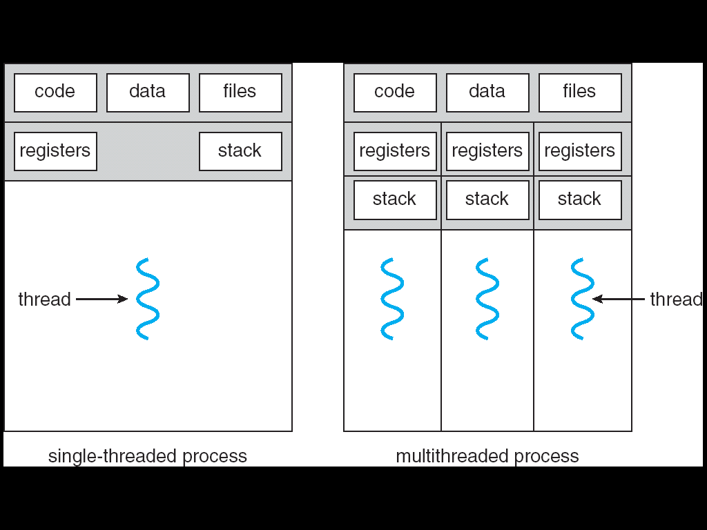
Recall: Traditional UNIX Process
Process: OS abstraction of what is needed to run a single program
Often called a “Heavyweight Process”
No concurrency in a “Heavyweight Process”
Two parts:
Sequential program execution stream [ACTIVE PART]
Code executed as a sequential stream of execution (i.e., thread)
Includes State of CPU registers
Protected resources [PASSIVE PART]:
Main memory state (contents of Address Space)
I/O state (i.e. file descriptors)

Slide 30
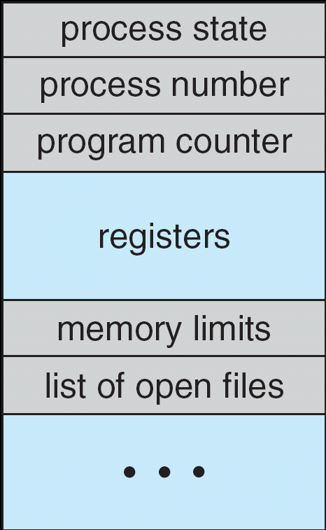
How do we Multiplex Processes?
The current state of process held in a process control block (PCB):
This is a “snapshot” of the execution and protection environment
Only one PCB active at a time
Give out CPU time to different processes (Scheduling):
Only one process “running” at a time
Give more time to important processes
Give pieces of resources to different processes (Protection):
Controlled access to non-CPU resources
Example mechanisms:
Memory Trnslation: Give each process their own address space
Kernel/User duality: Arbitrary multiplexing of I/O through system calls
Process Control
Block

Slide 31
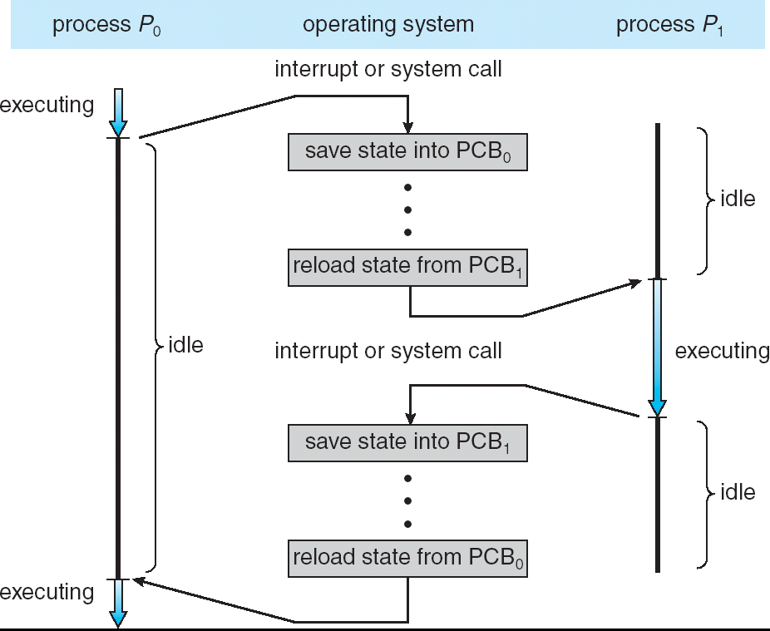
CPU Switch From Process A to Process B
This is also called a “context switch”
Code executed in kernel above is overhead
Overhead sets minimum practical switching time
Less overhead with SMT/hyperthreading, but… contention for resources instead

Slide 32
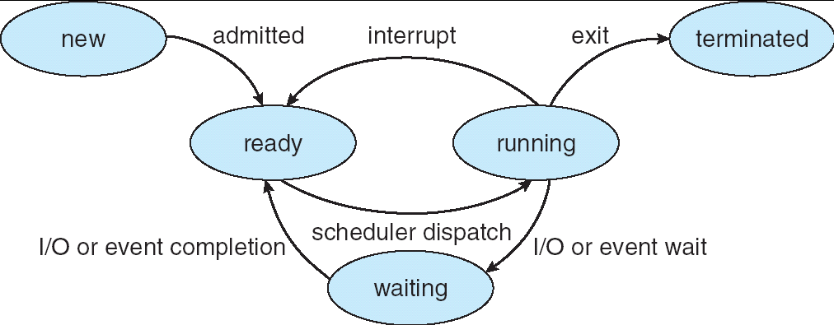
Lifecycle of a Process
As a process executes, it changes state:
new: The process is being created
ready: The process is waiting to run
running: Instructions are being executed
waiting: Process waiting for some event to occur
terminated: The process has finished execution

Slide 33
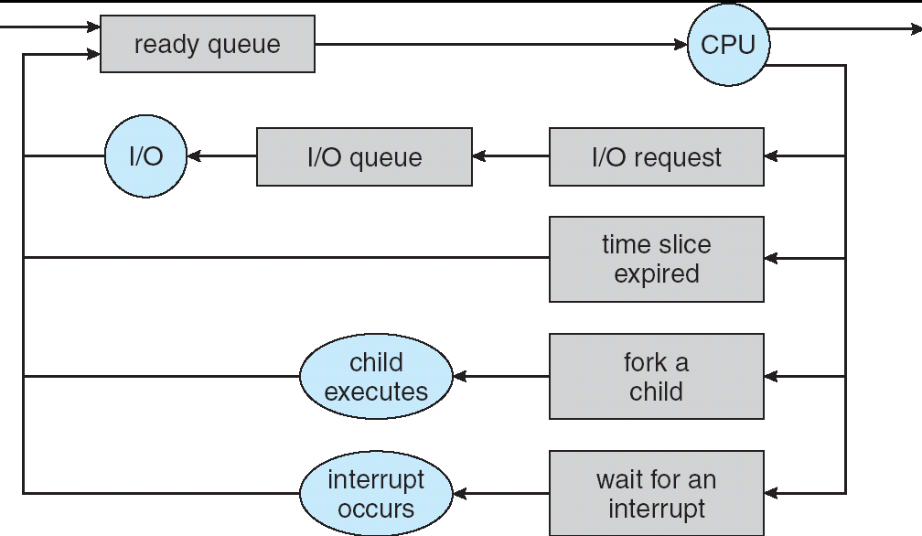
Process Scheduling
PCBs move from queue to queue as they change state
Decisions about which order to remove from queues are Scheduling decisions
Many algorithms possible (few weeks from now)

Slide 34
Ready Queue And Various I/O Device Queues
Process not running ⇒ PCB is in some scheduler queue
Separate queue for each device/signal/condition
Each queue can have a different scheduler policy
Ready
Queue
Head
Other
State
PCB₉
Link
Other
State
PCB₆
Link
Other
State
PCB₁₆
Link
Tail
Registers
Registers
Registers
USB
Unit 0
Head
Tail
Disk
Unit 0
Head
Other
State
PCB₂
Link
Other
State
PCB₃
Link
Tail
Registers
Registers
Disk
Unit 2
Head
Tail
Other
State
PCB₈
Ether
Netwk 0
Link
Head
Tail
Registers

Slide 35
Modern Process with Threads
Thread: a sequential execution stream within process (Sometimes called a “Lightweight process”)
Process still contains a single Address Space
No protection between threads
Multithreading: a single program made up of a number of different concurrent activities
Sometimes called multitasking, as in Ada …
Why separate the concept of a thread from that of a process?
Discuss the “thread” part of a process (concurrency)
Separate from the “address space” (protection)
Heavyweight Process ≡ Process with one thread

Slide 36
Single and Multithreaded Processes
Threads encapsulate concurrency: “Active” component
Address spaces encapsulate protection: “Passive” part
Keeps buggy program from trashing the system
Why have multiple threads per address space?
Notes:
Sometimes need parallelism for a single job, and processes are very expensive – to start, switch between, and to communicate between

Slide 37
Thread State
State shared by all threads in process/address space
Content of memory (global variables, heap)
I/O state (file descriptors, network connections, etc)
State “private” to each thread
Kept in TCB ≡ Thread Control Block
CPU registers (including, program counter)
Execution stack – what is this?
Execution Stack
Parameters, temporary variables
Return PCs are kept while called procedures are executing

Slide 38
Shared vs. Per-Thread State

Slide 39
Execution Stack Example
A(int tmp) {
if (tmp<2)
B();
printf(tmp);
}
B() {
C();
}
C() {
A(2);
}
A(1);
A:
A+1:
A+2:
B:
B+1:
C:
C+1:
exit:
Stack holds temporary results
Permits recursive execution
Crucial to modern languages

Slide 40
Execution Stack Example
A: tmp=1
ret=exit
A(int tmp) {
if (tmp<2)
B();
printf(tmp);
}
B() {
C();
}
C() {
A(2);
}
A(1);
Stack
Pointer
A:
A+1:
A+2:
B:
B+1:
C:
C+1:
exit:
Stack holds temporary results
Permits recursive execution
Crucial to modern languages

Slide 41
Execution Stack Example
A: tmp=1
ret=exit
A(int tmp) {
if (tmp<2)
B();
printf(tmp);
}
B() {
C();
}
C() {
A(2);
}
A(1);
Stack
Pointer
A:
A+1:
A+2:
B:
B+1:
C:
C+1:
exit:
Stack holds temporary results
Permits recursive execution
Crucial to modern languages

Slide 42
Execution Stack Example
A: tmp=1
ret=exit
A(int tmp) {
if (tmp<2)
B();
printf(tmp);
}
B() {
C();
}
C() {
A(2);
}
A(1);
Stack
Pointer
A:
A+1:
A+2:
B:
B+1:
C:
C+1:
exit:
Stack holds temporary results
Permits recursive execution
Crucial to modern languages

Slide 43
Execution Stack Example
A: tmp=1
ret=exit
A(int tmp) {
if (tmp<2)
B();
printf(tmp);
}
B() {
C();
}
C() {
A(2);
}
A(1);
A:
A+1:
A+2:
B:
B+1:
C:
C+1:
exit:
B: ret=A+2
Stack
Pointer
Stack holds temporary results
Permits recursive execution
Crucial to modern languages

Slide 44
Execution Stack Example
A: tmp=1
ret=exit
A(int tmp) {
if (tmp<2)
B();
printf(tmp);
}
B() {
C();
}
C() {
A(2);
}
A(1);
A:
A+1:
A+2:
B:
B+1:
C:
C+1:
exit:
B: ret=A+2
Stack
Pointer
Stack holds temporary results
Permits recursive execution
Crucial to modern languages

Slide 45
Execution Stack Example
A: tmp=1
ret=exit
A(int tmp) {
if (tmp<2)
B();
printf(tmp);
}
B() {
C();
}
C() {
A(2);
}
A(1);
A:
A+1:
A+2:
B:
B+1:
C:
C+1:
exit:
B: ret=A+2
C: ret=B+1
Stack
Pointer
Stack holds temporary results
Permits recursive execution
Crucial to modern languages

Slide 46
Execution Stack Example
A: tmp=1
ret=exit
A(int tmp) {
if (tmp<2)
B();
printf(tmp);
}
B() {
C();
}
C() {
A(2);
}
A(1);
A:
A+1:
A+2:
B:
B+1:
C:
C+1:
exit:
B: ret=A+2
C: ret=B+1
A: tmp=2
ret=C+1
Stack
Pointer
Stack Growth
Stack holds temporary results
Permits recursive execution
Crucial to modern languages

Slide 47
Execution Stack Example
A: tmp=1
ret=exit
A(int tmp) {
if (tmp<2)
B();
printf(tmp);
}
B() {
C();
}
C() {
A(2);
}
A(1);
A:
A+1:
A+2:
B:
B+1:
C:
C+1:
exit:
B: ret=A+2
C: ret=B+1
A: tmp=2
ret=C+1
Stack
Pointer
Stack Growth
Output:
>2
Stack holds temporary results
Permits recursive execution
Crucial to modern languages

Slide 48
Execution Stack Example
A: tmp=1
ret=exit
A(int tmp) {
if (tmp<2)
B();
printf(tmp);
}
B() {
C();
}
C() {
A(2);
}
A(1);
A:
A+1:
A+2:
B:
B+1:
C:
C+1:
exit:
B: ret=A+2
C: ret=B+1
A: tmp=2
ret=C+1
Stack
Pointer
Stack Growth
Output:
>2
Stack holds temporary results
Permits recursive execution
Crucial to modern languages

Slide 49
Execution Stack Example
A: tmp=1
ret=exit
A(int tmp) {
if (tmp<2)
B();
printf(tmp);
}
B() {
C();
}
C() {
A(2);
}
A(1);
A:
A+1:
A+2:
B:
B+1:
C:
C+1:
exit:
B: ret=A+2
C: ret=B+1
Stack
Pointer
Output:
>2
Stack holds temporary results
Permits recursive execution
Crucial to modern languages

Slide 50
Execution Stack Example
A: tmp=1
ret=exit
A(int tmp) {
if (tmp<2)
B();
printf(tmp);
}
B() {
C();
}
C() {
A(2);
}
A(1);
A:
A+1:
A+2:
B:
B+1:
C:
C+1:
exit:
B: ret=A+2
Stack
Pointer
Output:
>2
Stack holds temporary results
Permits recursive execution
Crucial to modern languages

Slide 51
Execution Stack Example
A: tmp=1
ret=exit
A(int tmp) {
if (tmp<2)
B();
printf(tmp);
}
B() {
C();
}
C() {
A(2);
}
A(1);
Stack
Pointer
A:
A+1:
A+2:
B:
B+1:
C:
C+1:
exit:
Output:
>2 1
Stack holds temporary results
Permits recursive execution
Crucial to modern languages

Slide 52
Execution Stack Example
A: tmp=1
ret=exit
A(int tmp) {
if (tmp<2)
B();
printf(tmp);
}
B() {
C();
}
C() {
A(2);
}
A(1);
Stack
Pointer
A:
A+1:
A+2:
B:
B+1:
C:
C+1:
exit:
Output:
>2 1
Stack holds temporary results
Permits recursive execution
Crucial to modern languages

Slide 53
Execution Stack Example
A(int tmp) {
if (tmp<2)
B();
printf(tmp);
}
B() {
C();
}
C() {
A(2);
}
A(1);
Output:
>2 1
Stack holds temporary results
Permits recursive execution
Crucial to modern languages

Slide 54
Execution Stack Example
A: tmp=1
ret=exit
A(int tmp) {
if (tmp<2)
B();
printf(tmp);
}
B() {
C();
}
C() {
A(2);
}
A(1);
Stack
Pointer
B: ret=A+2
C: ret=b+1
A: tmp=2
ret=C+1
Stack Growth
Stack holds temporary results
Permits recursive execution
Crucial to modern languages

Slide 55
Motivational Example for Threads
Imagine the following C program:
main() {
ComputePI(̎pi.txt̎);
PrintClassList(̎classlist.txt̎);
}
What is the behavior here?
Program would never print out class list
Why? ComputePI would never finish

Slide 56
Use of Threads
Version of program with Threads (loose syntax):
main() {
ThreadFork(ComputePI, ̎pi.txt̎));
ThreadFork(PrintClassList, ̎classlist.txt̎));
}
What does ThreadFork() do?
Start independent thread running given procedure
What is the behavior here?
Now, you would actually see the class list
This should behave as if there are two separate CPUs
CPU1
CPU2
CPU1
CPU2
CPU1
CPU2
Time

Slide 57
Memory Footprint: Two-Threads
If we stopped this program and examined it with a debugger, we would see
Two sets of CPU registers
Two sets of Stacks
Questions:
How do we position stacks relative to each other?
What maximum size should we choose for the stacks?
What happens if threads violate this?
How might you catch violations?
Stack 1
Stack 2
Address Space
Heap
Global Data
Code

Slide 58
Actual Thread Operations
thread_fork(func, args)
Create a new thread to run func(args)
Pintos: thread_create
thread_yield()
Relinquish processor voluntarily
Pintos: thread_yield
thread_join(thread)
In parent, wait for forked thread to exit, then return
Pintos: thread_join
thread_exit
Quit thread and clean up, wake up joiner if any
Pintos: thread_exit
pThreads: POSIX standard for thread programming [POSIX.1c, Threads extensions (IEEE Std 1003.1c-1995)]

Slide 59
Dispatch Loop
Conceptually, the dispatching loop of the operating system looks as follows:
Loop {
RunThread();
ChooseNextThread();
SaveStateOfCPU(curTCB);
LoadStateOfCPU(newTCB);
}
This is an infinite loop
One could argue that this is all that the OS does
Should we ever exit this loop???
When would that be?
Notes:
Emergency crash of operating system called “panic()”

Slide 60
Running a thread
Consider first portion: RunThread()
How do I run a thread?
Load its state (registers, PC, stack pointer) into CPU
Load environment (virtual memory space, etc)
Jump to the PC
How does the dispatcher get control back?
Internal events: thread returns control voluntarily
External events: thread gets preempted
Notes:
OS’s have almost human characteristics – unpredictable, hard to understand, …
Different things share the same CPU – one thread, then another
Similar to schizophrenia, like the movie Sybil, one body shared by several people, say we start with Dave Patterson
Threads are like the personalities of the CPU. First one thread/personality uses the CPU, then another,…

Slide 61
Internal Events
Blocking on I/O
The act of requesting I/O implicitly yields the CPU
Waiting on a “signal” from other thread
Thread asks to wait and thus yields the CPU
Thread executes a yield()
Thread volunteers to give up CPU
computePI() {
while(TRUE) {
ComputeNextDigit();
yield();
}
}
Notes:
Yield is for really nice people – Ever see two people at the supermarket checkout line? You first, no you first, …

Slide 62
Stack for Yielding Thread
ComputePI
yield
Trap to OS
kernel_yield
Stack growth
run_new_thread
switch
How do we run a new thread?
run_new_thread() {
newThread = PickNewThread();
switch(curThread, newThread);
ThreadHouseKeeping(); /* Do any cleanup */
}
How does dispatcher switch to a new thread?
Save anything next thread may trash: PC, regs, stack pointer
Maintain isolation for each thread

Slide 63
What Do the Stacks Look Like?
Consider the following code blocks:
proc A() {
B();
}
proc B() {
while(TRUE) {
yield();
}
}
Suppose we have 2 threads:
Threads S and T
Thread S
Thread T
A
A
B(while)
B(while)
Stack growth
yield
yield
run_new_thread
run_new_thread
switch
switch

Slide 64
Saving/Restoring state (often called “Context Switch)
Switch(tCur,tNew) {
/* Unload old thread */
TCB[tCur].regs.r7 = CPU.r7;
…
TCB[tCur].regs.r0 = CPU.r0;
TCB[tCur].regs.sp = CPU.sp;
TCB[tCur].regs.retpc = CPU.retpc; /*return addr*/
/* Load and execute new thread */
CPU.r7 = TCB[tNew].regs.r7;
…
CPU.r0 = TCB[tNew].regs.r0;
CPU.sp = TCB[tNew].regs.sp;
CPU.retpc = TCB[tNew].regs.retpc;
return; /* Return to CPU.retpc */
}

Slide 65
Switch Details (continued)
What if you make a mistake in implementing switch?
Suppose you forget to save/restore register 32
Get intermittent failures depending on when context switch occurred and whether new thread uses register 32
System will give wrong result without warning
Can you devise an exhaustive test to test switch code?
No! Too many combinations and inter-leavings
Cautionary tale:
For speed, Topaz kernel saved one instruction in switch()
Carefully documented! Only works as long as kernel size < 1MB
What happened?
Time passed, People forgot
Later, they added features to kernel (no one removes features!)
Very weird behavior started happening
Moral of story: Design for simplicity

Slide 66
Summary
Socket: an abstraction of a network I/O queue (IPC mechanism)
Processes have two parts
One or more Threads (Concurrency)
Address Spaces (Protection)
Concurrency accomplished by multiplexing CPU Time:
Unloading current thread (PC, registers)
Loading new thread (PC, registers)
Such context switching may be voluntary (yield(), I/O operations) or involuntary (timer, other interrupts)

